Slide 1
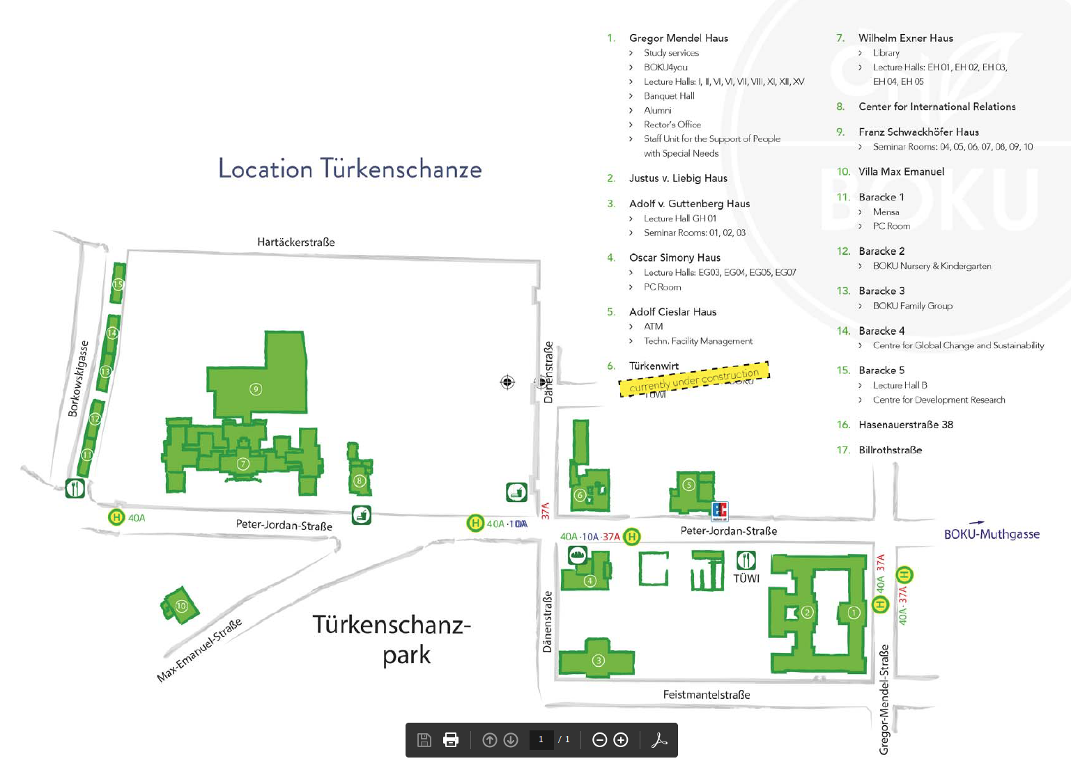
Top Floor!

Slide 2




Development of master curricula for natural disasters risk management in Western Balkan countries
Introduction in WP1
“Analysis of natural disasters needed to be managed in Western Balkan region“
Priv.-Doz. DI Dr. Michael Tritthart
University of Natural Resources and Life Sciences BOKU, Vienna
Workshop Workshop on master curricula
best practices in EU partners
5th April 2017
Project number: 573806-EPP-1-2016-1-RS-EPPKA2-CBHE-JP
"This project has been funded with support from the European Commission. This publication reflects the views only of the author, and the Commission cannot be held responsible for any use which may be made of the information contained therein"

Slide 3
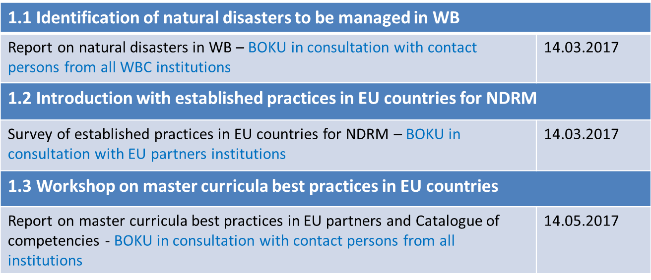
WP1 – to do list
Analysis of natural disasters needed to be managed in Western Balkan region
Development of master curricula for natural disasters risk management in Western Balkan countries
✓
✓
(✓)

Slide 4
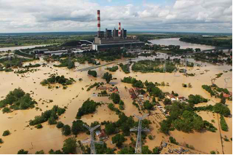
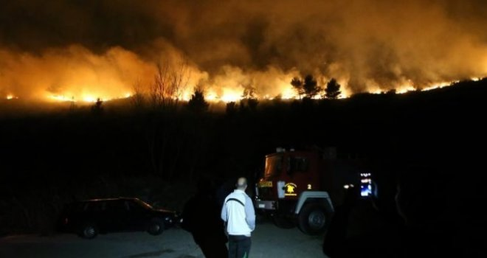
Management of WP1.1
Development of master curricula for natural disasters risk management in Western Balkan countries
1.1 Identification of natural disasters to be managed in WB
Cooperation between BOKU and all partners from Western Balkan (Bosnia and Herzegovina, Kosovo*, Serbia)
Identification of natural disasters
  Types of extreme events including landslides, earthquakes,
  floods, etc.
Analysis of risk management
  Established practices and
  Assessment of existing management
Analysis of responsible institutes
  Organizational structures
  Management responsibilities
Floods in Serbia 2014
Wild Fire in B&H 2017

Slide 5
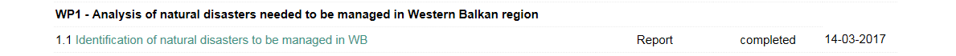
Management of WP1.1
Development of master curricula for natural disasters risk management in Western Balkan countries
1.1 Identification of natural disasters to be managed in WB
Cooperation between BOKU and all partners from Western Balkan (Bosnia and Herzegovina, Kosovo*, Serbia)
“Road Map”:
Information for Western Balkan countries about required information
Separate reports on natural disasters for each WB countries
Overall report on natural disasters in Western Balkan
Jan. 2017
Jan-Mar.
2017
Mar. 2017
http://www.natrisk.ni.ac.rs/activities
→ Presentations in the 1st session of this workshop (today!)

Slide 6
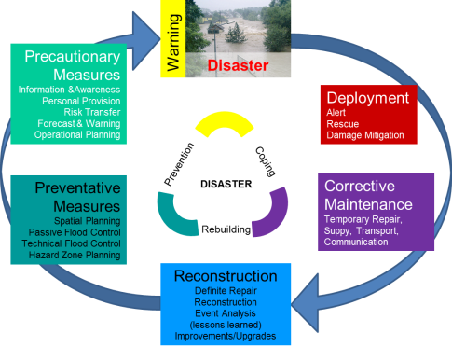
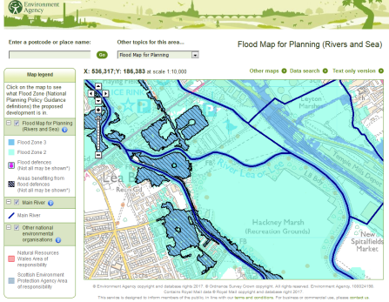
Management of WP1.2
Development of master curricula for natural disasters risk management in Western Balkan countries
1.2 Introduction with established practices in EU countries for NDRM
Cooperation between BOKU and all partners from EU (Austria, Greece, Hungary, Italy, United Kingdom)
Identification of natural disasters
  Types of extreme events including earthquakes, floods, etc.
Analysis of established risk management strategies
  Linkage to existing EU guidelines
  Established practices
Analysis of responsible institutes
  Organizational structures
  Management responsibilities
Assessment of risk management aspects
  Advantages & disadvantages
  Knowledge gaps
Analysis of EU master curricula
Integrated natural hazard management in Austria
Flood Map for Planning in UK

Slide 7
Management of WP1.2
Development of master curricula for natural disasters risk management in Western Balkan countries
1.2 Introduction with established practices in EU countries for NDRM
Cooperation between BOKU and all partners from EU (Austria, Greece, Hungary, Italy, United Kingdom)
“Road Map”:
Information for EU partners about required information
Separate reports on established practices for each EU partner
Overall report on established practices in EU countries
Jan. 2017
Jan-Mar.
2017
Mar. 2017
http://www.natrisk.ni.ac.rs/activities
→ Presentations in the 2nd session of this workshop (Thursday morning)

Slide 8
Management of WP1.3
Development of master curricula for natural disasters risk management in Western Balkan countries
1.3 Workshop on master curricula best practices in EU countries
Cooperation between BOKU and all partners
Workshop
  Identification of natural disasters
  Established risk management strategies
  Existing EU master curricula
TODO: Report on master curricula
TODO: Catalogue of competencies for students
Presentations of the 3rd session of this workshop (Friday morning)
Cooperation with WB partners for catalogue of competencies
Basis for WP 2 “Development of master curricula”

Slide 9

Contact information
Development of master curricula for natural disasters risk management in Western Balkan countries
University of Natural Resources and Life Sciences Vienna (BOKU)
Department of Water, Atmosphere and Environment (WAU)
Institute of Water Management, Hydrology
and Hydraulic Engineering (IWHW)
Michael Tritthart
Priv.-Doz. Dipl.-Ing. Dr.techn.
E-mail: michael.tritthart@boku.ac.at
Kurt Glock
Dipl.-Ing.
E-mail: kurt.glock@boku.ac.at

